Slide 1
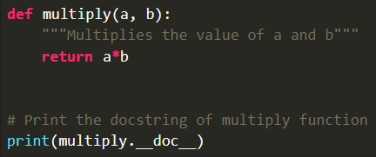


Basic
형식 모음
글자
Comment Single line comment( # ) Multiline comment( Multi # ) String literal( single (‘comment script') / ( “”” )) → python ignore string literals that aren’t assign to variable(So, can use comment) like ‘hello’ Docstring comment( “”” ) → Using triple quotes(“””) → Docstring appears right after function like def func1: ... , “comment is ...”, print(func1.__doc__) → Using __doc__ attribute, can print comment of function, module, class
메인 내용
코드
(x₁, y₁)
(x₂, y₂)
(x_{m}, y_{m})
Result
Inside first_space
Ctrl+ = ➔ 아래첨자 Ctrl + shift + = ➔ 윗첨자 Ctrl + space ➔ 복구 Shift + f3 ➔ 대소문자 변경
예시 표시
Partition
그림 설명
예시
Code
예시
code
Mismatch
글자설명
Pattern
(-2,-2) | (-2,-1) | (-2,0) | (-2,1) | (-2,2)
(-1,-2) | (-1,-1) | (-1,0) | (-1,1) | (-1,2)
(0,-2) | (0,-1) | (x,y) | (0,1) | (0,2)
(1,-2) | (1,-1) | (1,0) | (1,1) | (1,2)
(2,-2) | (2,-1) | (2,0) | (2,1) | (2,2)
Notes:
https://www.geeksforgeeks.org/python-comments/

Slide 2

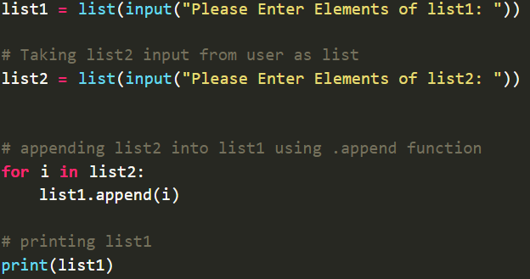
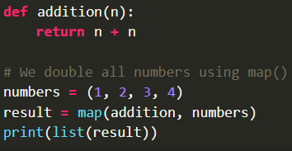

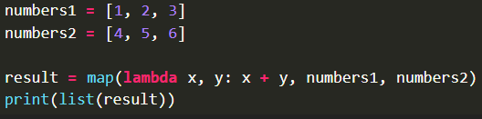
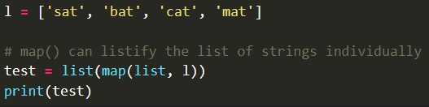
Input (1)
형식 모음
글자
Input input(prompt) → It takes user input and converts “string” → If input function is called, program stop and wait user input → Type of returned object is <class ‘str’> → In Python 2.x, automatically convert input type - Vulnerability: variable/function name as parameter → in Python 3.x, explicitly convert input type raw_input(prompt) → old version(python 2.x), it similar input() in Python 3.x → Use method is same as input function Multiple Input → Using split(), map(), get multiple input → split() is used to separate string - syntax: input().split(separator, maxsplit) → separator: delimiter(default: white space) → maxsplit: number(default: -1(no limit) - If empty in (), white space is separator → map() is used to convert string to int or float - return map object(iterator) - map(fun, iter) → fun: function to which map passes each elements of iterable → iter: iterable which is to be mapped → Ex) x, y = input(), input() → Ex) x, y = input(“enter 2 values: “).split() # input value: 2, 5 print(x) # print 2 print(y) # print 5 m, n = map(int, input().split())
메인 내용
코드
(x₁, y₁)
(x₂, y₂)
(x_{m}, y_{m})
Result
Inside first_space
Ctrl+ = ➔ 아래첨자 Ctrl + shift + = ➔ 윗첨자 Ctrl + space ➔ 복구 Shift + f3 ➔ 대소문자 변경
예시 표시
Partition
그림 설명
예시
Code
예시
code
Mismatch
글자설명
Pattern
(-2,-2) | (-2,-1) | (-2,0) | (-2,1) | (-2,2)
(-1,-2) | (-1,-1) | (-1,0) | (-1,1) | (-1,2)
(0,-2) | (0,-1) | (x,y) | (0,1) | (0,2)
(1,-2) | (1,-1) | (1,0) | (1,1) | (1,2)
(2,-2) | (2,-1) | (2,0) | (2,1) | (2,2)
Notes:
https://www.geeksforgeeks.org/taking-input-in-python/?ref=outind

Slide 3
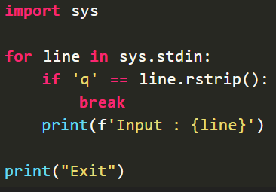
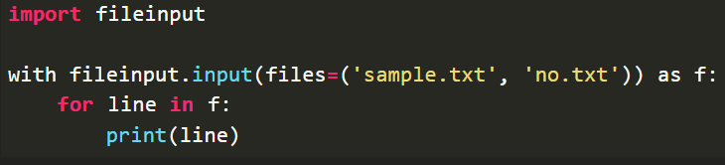
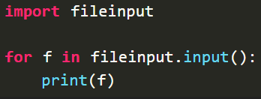
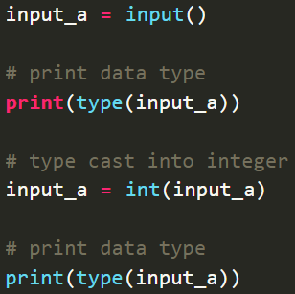
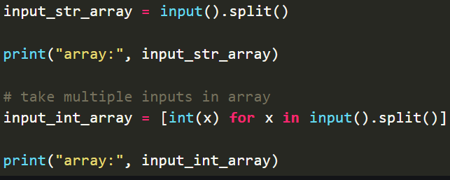
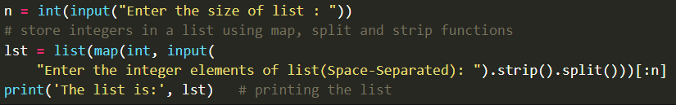
Input (2)
형식 모음
글자
Input from stdin → sys.stdin - import sys module - get input from command line and internally call input(), automatically add ‘\n’ → input() → fileinput.input() - import fileinput module - Reading multiple files → Using fileinput.input() with providing file names → Using fileinput.input() with command line Integer Input
메인 내용
코드
(x₁, y₁)
(x₂, y₂)
(x_{m}, y_{m})
Result
Inside first_space
Ctrl+ = ➔ 아래첨자 Ctrl + shift + = ➔ 윗첨자 Ctrl + space ➔ 복구 Shift + f3 ➔ 대소문자 변경
예시 표시
Partition
그림 설명
예시
Code
예시
code
Mismatch
글자설명
Pattern
(-2,-2) | (-2,-1) | (-2,0) | (-2,1) | (-2,2)
(-1,-2) | (-1,-1) | (-1,0) | (-1,1) | (-1,2)
(0,-2) | (0,-1) | (x,y) | (0,1) | (0,2)
(1,-2) | (1,-1) | (1,0) | (1,1) | (1,2)
(2,-2) | (2,-1) | (2,0) | (2,1) | (2,2)
Notes:
https://www.geeksforgeeks.org/taking-input-in-python/?ref=outind

Slide 4
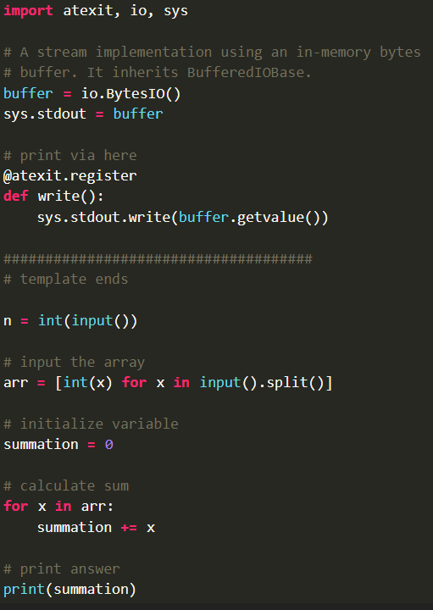
Input (3)
형식 모음
글자
Datatype of Input → a = “hello” ➔ <class ‘str’> b = 10 ➔ <class ‘int’> c = 11.2 ➔ <class ‘float’> d = (“val1”, “val2”, “val3”) ➔ <class ‘tuple’> e = {“val1”:1, “val2”:2, “val3”:3} ➔ <class ‘dic’> f = [“val1”, “val2”, “val3”] ➔ <class ‘list’> Single Character Input → Using loop(if-else) statement and len() → Using string indexing - Ex) a = input()[0] # input: asdf print(a) ➔ a - Ex) a = input()[2] # input: asdf print(a) ➔ d - Ex) a = input()[-1] # input: asdf print(a) ➔ f input() vs sys.stdin.readline() → input() can’t read escape character, sys.stdin.readline() can read escape character → input() can’t read input data by limiting string length, sys.stdin.readline() can read input data by limiting string length Fast I/O → Ex) def get_ints(): return map(int, sys.stdin.readline().strip().split()) a, b, c, d = get_ints() → Ex) def get_string(): return sys.stdin.readline().strip() string = get_string() → Adding buffered pipe io - Adding buffered IO code before submission code to make output faster - io.BytesIO objects implements common interface(file-like object) - BytesIO objects have internal pointer, every call of read(n) pointer advances - atexit module provides simple interface to register function to be called when program closes down normally - Ex) input = io.BytesIO(os.read(0, os.fstat(0).st_size)).readline s = input().decode() sys.stdout.write(str(n)+”\n”)#integer, write(s)#string, write(“ “.join(map(str,arr))+”\n”) #array(list)
※ type(variable_name) type() gets return value’s type of variable Ex) val = input(“enter:”), print(type(val)) ➔ <class ‘str’> Ex) val = int(input(“enter:”)), print(type(val)) ➔ <class ‘int’>
(x₁, y₁)
메인 내용
코드
(x₂, y₂)
(x_{m}, y_{m})
Result
Inside first_space
Ctrl+ = ➔ 아래첨자 Ctrl + shift + = ➔ 윗첨자 Ctrl + space ➔ 복구 Shift + f3 ➔ 대소문자 변경
예시 표시
Partition
그림 설명
예시
Code
예시
code
Mismatch
글자설명
Pattern
(-2,-2) | (-2,-1) | (-2,0) | (-2,1) | (-2,2)
(-1,-2) | (-1,-1) | (-1,0) | (-1,1) | (-1,2)
(0,-2) | (0,-1) | (x,y) | (0,1) | (0,2)
(1,-2) | (1,-1) | (1,0) | (1,1) | (1,2)
(2,-2) | (2,-1) | (2,0) | (2,1) | (2,2)
Notes:
https://www.geeksforgeeks.org/taking-input-in-python/?ref=outind

Slide 5
Input (4)
형식 모음
글자
Input as list or tuple → Ex) lst = [], n = int(input()) #Using Loop for i in range(0, n): ele = int(input()) lst.append(ele) → Ex) for i in range(0, n): #Using list of lists ele = [input(), int(input())] lst.append(ele) → Ex) try: #Using Exception Handling lst = [] while True: lst.append(int(input())) except: print(lst) → Ex) a = list(map(int, input().strip().split()))[:n] #Using map() → Ex) x, y = [int(t) for t in input().split()] #input: 2, 3 print(“{}, {}”.format(x, y)) ➔ 2, 3 → Ex) x = [int(x) for x in sys.stdin.readline().split()] #input: 2 3 4 print(x) ➔ [2, 3, 4] → Ex) n = list(map(int, input().split())) #input: 4, 5, 6, 1, 56, 21 print(n) ➔ [4, 5, 6, 1, 56, 21] → Ex) str, *lst = input().split() #input: hello 2 0 2 0 lst = list(map(int, lst)) print(str, lst) ➔ hello [2, 0, 2, 0]
메인 내용
코드
(x₁, y₁)
(x₂, y₂)
(x_{m}, y_{m})
Result
Inside first_space
Ctrl+ = ➔ 아래첨자 Ctrl + shift + = ➔ 윗첨자 Ctrl + space ➔ 복구 Shift + f3 ➔ 대소문자 변경
예시 표시
Partition
그림 설명
예시
Code
예시
code
Mismatch
글자설명
Pattern
(-2,-2) | (-2,-1) | (-2,0) | (-2,1) | (-2,2)
(-1,-2) | (-1,-1) | (-1,0) | (-1,1) | (-1,2)
(0,-2) | (0,-1) | (x,y) | (0,1) | (0,2)
(1,-2) | (1,-1) | (1,0) | (1,1) | (1,2)
(2,-2) | (2,-1) | (2,0) | (2,1) | (2,2)
Notes:
https://www.geeksforgeeks.org/taking-input-in-python/?ref=outind

Slide 6
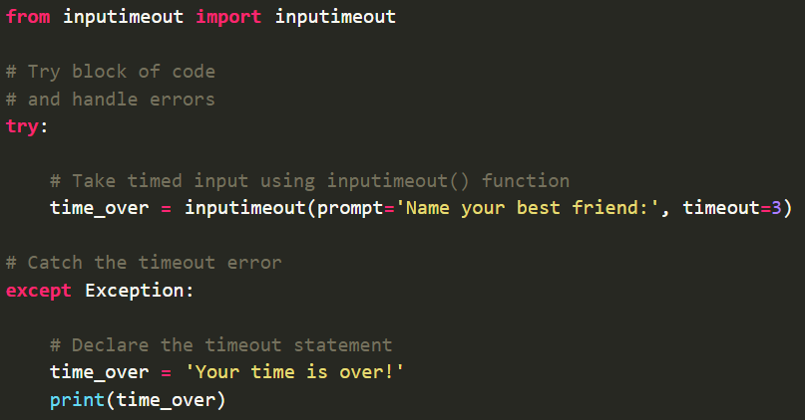

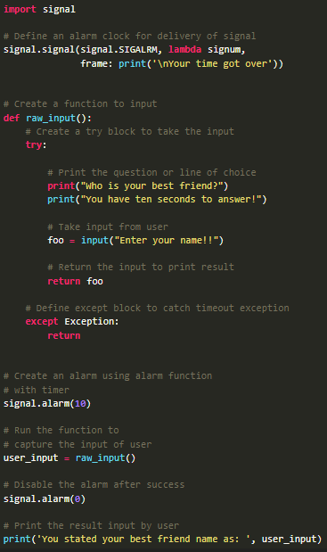
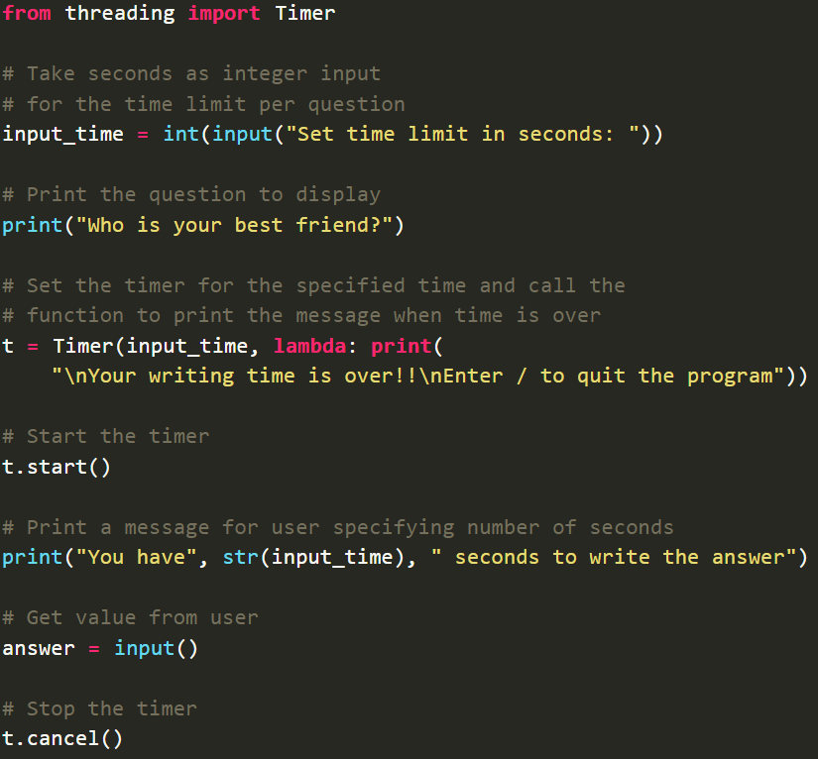
Input Time Limit
형식 모음
글자
Input Time Limit Method → Using inputimeout module - Module installation: pip install inputimeout - It can be used on multiple platforms - Using try-except statement, handle timeout error → Using select module - Module installation: pip install select - It can be used for connection to platform-specific input-output monitoring functions - Using if-else statement, handle timeout statement → Using signal module - Module installation: pip install signal - Receiving info from OS, pass info to program in form of signals - Define signal handler, create alarm function → Using threading module - Module installation: pip install threading - Using Timer in threading
메인 내용
코드
(x₁, y₁)
(x₂, y₂)
(x_{m}, y_{m})
Result
Inside first_space
Ctrl+ = ➔ 아래첨자 Ctrl + shift + = ➔ 윗첨자 Ctrl + space ➔ 복구 Shift + f3 ➔ 대소문자 변경
예시 표시
Partition
그림 설명
예시
Code
예시
code
Mismatch
글자설명
Pattern
(-2,-2) | (-2,-1) | (-2,0) | (-2,1) | (-2,2)
(-1,-2) | (-1,-1) | (-1,0) | (-1,1) | (-1,2)
(0,-2) | (0,-1) | (x,y) | (0,1) | (0,2)
(1,-2) | (1,-1) | (1,0) | (1,1) | (1,2)
(2,-2) | (2,-1) | (2,0) | (2,1) | (2,2)
Notes:
https://www.geeksforgeeks.org/taking-input-in-python/?ref=outind

Slide 7
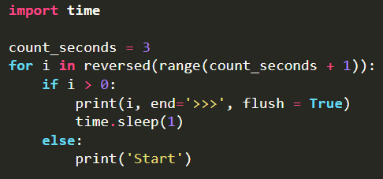
Output (1)
형식 모음
글자
Output various output formats( format(), manipulation of sep and end parameters, f-strings, versatile % operator) print() function syntax → print(value(s), sep=‘’, end=‘\n’, file=file, flush=flush) → sep default: ‘’ → end default: ‘\n’ → file default: sys.stdout ➔ file: object with write method → flush default: false ➔ flush: specifying if output is flushed(true) or buffered(false) using boolean - If flush is true, each statement is printed separately - If flush is false, each statement is printed simultaneously → Using + operator, concatenating string is possible Ex) print(‘val1 is ‘ + ‘defined’) ➔ val1 is defined Using format() → Ex) amout = 150.75, print(“amout: ${:.2f}”.format(amount)) ➔ amout: $150.75 → Ex) print(‘{0} and {1}’.format(‘A’, ‘B’)) ➔ A and B → Ex) print(‘{1} and {0}’.format(‘A’, ‘B’)) ➔ B and A → Ex) print(“Val1: {0: 2d}, Val2: {other:7.2f}”.format(52, other=23.54)) ➔ Val1: 52, Val2: 23.54 → Ex) tab = {‘val1’ : 12, ‘val2’:34, ‘val3’:56} print(‘val1: {0[val1]:d}, val2: {0[val2]:d}, val3: {0[val3]:d}’.format(tab)) ➔ val1: 12, val2: 34, val3: 56 → Ex) data = dict(val1= “hello”, val2=“world”) print(“{val1} {val2}”.format(**data)) ➔ hello world Using sep and end parameter → sep(separator) is used for separating words → end is used for denoting last word → Ex) print(“Val1”, end=‘@’) print(“Val2”) ➔ Val1@Val2 print(‘G’, ‘F’, ‘G’, sep=‘’) ➔ GFG print(’09’, ‘12’, ‘2016’, sep=‘-’) ➔ 09-12-2016 print(‘’val3’, ‘val4’, sep=‘@’) ➔ val3@val4 Using f-string → Ex) name = ‘val1’, age = 23, print(f”hello, my name is {name} and I’m {age} years old.”) ➔ hello, my name is val1 and I’m 23 years old.
메인 내용
코드
(x₁, y₁)
(x₂, y₂)
(x_{m}, y_{m})
Result
Inside first_space
Ctrl+ = ➔ 아래첨자 Ctrl + shift + = ➔ 윗첨자 Ctrl + space ➔ 복구 Shift + f3 ➔ 대소문자 변경
예시 표시
Partition
그림 설명
예시
Code
예시
code
Mismatch
글자설명
Pattern
(-2,-2) | (-2,-1) | (-2,0) | (-2,1) | (-2,2)
(-1,-2) | (-1,-1) | (-1,0) | (-1,1) | (-1,2)
(0,-2) | (0,-1) | (x,y) | (0,1) | (0,2)
(1,-2) | (1,-1) | (1,0) | (1,1) | (1,2)
(2,-2) | (2,-1) | (2,0) | (2,1) | (2,2)
Notes:
https://www.geeksforgeeks.org/taking-input-in-python/?ref=outind

Slide 8
Output (2)
형식 모음
글자
Using String Modulo Operator(%) → string formatting을 위해 string class에 의해 overloading 됨 → Format string + String modulo operator + Tuple with value 형태 → %[flags][width][.precision]type → Ex) print(“val1: %2d, val2: %5.2f” % (1, 05.333)) print(“val3: %3d, val4: %2d” % (240, 120)) print(“%7.3o” % (25)) #8진수 변환 print(“%10.3E” % (356.08977)) #지수형태 변환 ➔ val1: 1, val2: 5.33, val3: 240, val4: 120, 031, 3.561E+02 Using String Alignment Method → For string alignment, use str.ljust(s, width[,fillchar]), str.rjust(s, width[,fillchar]), str.centre(s, width[,fillchar]) - fillchar default: white space → Ex) cstr = “Hello World” print(cstr.centre(21, ‘#’)) ➔ #####Hello World##### print(cstr.ljust(21, ‘-’)) ➔ Hello World---------- print(cstr.rjust(21, ‘-’)) ➔ ----------Hello World Format Conversion Rule → d: decimal integer, b: binary integer, o: octal format, e(E): exponential notation, f: float-point decimal, g(G): general format, c: single character → r: string format using repr(), s: string format using str() Example of Output → lst = [‘I’, ‘like’, ‘cheese’] for i in lst: print(i, end=‘ ’) ➔ I like cheese → words_str = input() #input: geeks for geeks words = {word: len(word) for word in words_str.split()} print(words) ➔ {‘geeks’: 5, ‘for’: 3}
메인 내용
코드
(x₁, y₁)
(x₂, y₂)
(x_{m}, y_{m})
Result
Inside first_space
Ctrl+ = ➔ 아래첨자 Ctrl + shift + = ➔ 윗첨자 Ctrl + space ➔ 복구 Shift + f3 ➔ 대소문자 변경
예시 표시
Partition
그림 설명
예시
Code
예시
code
Mismatch
글자설명
Pattern
(-2,-2) | (-2,-1) | (-2,0) | (-2,1) | (-2,2)
(-1,-2) | (-1,-1) | (-1,0) | (-1,1) | (-1,2)
(0,-2) | (0,-1) | (x,y) | (0,1) | (0,2)
(1,-2) | (1,-1) | (1,0) | (1,1) | (1,2)
(2,-2) | (2,-1) | (2,0) | (2,1) | (2,2)
Notes:
https://www.geeksforgeeks.org/taking-input-in-python/?ref=outind

Slide 9
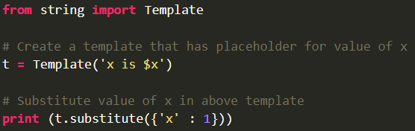
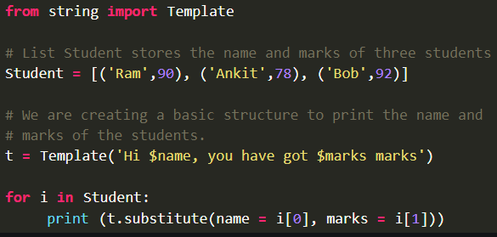
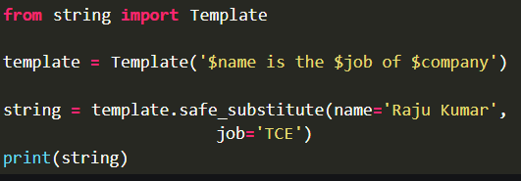
Output (3)
형식 모음
글자
String Template Class → placeholder name formed by $ and valid identifiers is used → Surrounding placeholder with braces allow more letters with no intervening spaces → && create single escaped $ → Method - template is created by passing template string to its contructor - substitute(mapping, **kwds) → Using dictionary → If key based mapping object, keyword have same key, throw TypeError → If keys are missing, return KeyError - safe_substitute(mapping, **kwds) → Similar substitute method, but doesn’t throw KeyError if key is missing → return placeholder - If placeholder isn’t supplied in dictionary or keyword, KeyError raised - template attribute used to return template string(Ex. t = Template(‘I $key’), print(‘=‘, t.template) - ${Identifier} is similar $Identifier, but partially substitute characters
메인 내용
코드
(x₁, y₁)
(x₂, y₂)
(x_{m}, y_{m})
Result
Inside first_space
Ctrl+ = ➔ 아래첨자 Ctrl + shift + = ➔ 윗첨자 Ctrl + space ➔ 복구 Shift + f3 ➔ 대소문자 변경
예시 표시
Partition
그림 설명
예시
Code
예시
code
Mismatch
글자설명
Pattern
(-2,-2) | (-2,-1) | (-2,0) | (-2,1) | (-2,2)
(-1,-2) | (-1,-1) | (-1,0) | (-1,1) | (-1,2)
(0,-2) | (0,-1) | (x,y) | (0,1) | (0,2)
(1,-2) | (1,-1) | (1,0) | (1,1) | (1,2)
(2,-2) | (2,-1) | (2,0) | (2,1) | (2,2)
Notes:
https://www.geeksforgeeks.org/taking-input-in-python/?ref=outind

Slide 10
Operator (1)
형식 모음
글자
Python Operator Arithmetic Operator → +, -, *, %, / (In python 2.x, / return integer, in python 3.x / return float) → // (division floor-return integer) → ** (power) → Precedence - Parentheses, Exponentiation, Multiplication/Division, Addition/Substraction Comparison Operator → <, <=, >, >=, ==, != → Precedence - Arithmetic operator > Comparison operator - Comparison operator has same precedence Logical Operator → and, or, not → Precedence - not > and > or Bitwise Operator → &, |, <<, >>, ~, ^ → Precedence - not > shift > and > xor > or Assignment Operator → =, +=, -=, *=, %= Identity Operator → is, is not → To check if 2 values are located on same part of memory Membership Operator → in, not in → To test whether value or variable is in a sequence Ternary Operator → [on_true] if [expression] else [on_false]
메인 내용
코드
(x₁, y₁)
(x₂, y₂)
(x_{m}, y_{m})
Result
Inside first_space
Ctrl+ = ➔ 아래첨자 Ctrl + shift + = ➔ 윗첨자 Ctrl + space ➔ 복구 Shift + f3 ➔ 대소문자 변경
예시 표시
Partition
그림 설명
예시
Code
예시
code
Mismatch
글자설명
Pattern
(-2,-2) | (-2,-1) | (-2,0) | (-2,1) | (-2,2)
(-1,-2) | (-1,-1) | (-1,0) | (-1,1) | (-1,2)
(0,-2) | (0,-1) | (x,y) | (0,1) | (0,2)
(1,-2) | (1,-1) | (1,0) | (1,1) | (1,2)
(2,-2) | (2,-1) | (2,0) | (2,1) | (2,2)
Notes:
https://www.geeksforgeeks.org/taking-input-in-python/?ref=outind

Slide 11
Variable (1)
형식 모음
글자
Variable variable is container variable name must start with letter / underscore (can’t start with number) variable name is case-sensitive(name, Name, NAME are different) Using =, assign single value to variable like a = b = c = 10 Using ,, assign different value to multiple variables like a, b, c = 1, 20.2, “hello” If use same name variable, variable refers to new value and type like a = 10, a = “hello” global keyword is declared inside function(not outside function) Single variable → Using print() → Using concatenation Ex) name = “asd”, print(“Name:”, name) ➔ Name: asd → Using f-string Ex) name = “dsa”, print(f”Name: {name}”) ➔ Name: dsa Multiple variable → Using unpacking Ex) name, age, city = “John”, 30, “New York”, print(name) ➔ John → Using multiple assignment Ex) a, b, c = 1, 2, 3, print(a, b, c) ➔ 1 2 3 → Using f-string - f-string(formatted string literal) - If f-string uses dictionary variable and accesses value of dictionary, use ‘’ like {person[‘name’]} (person: variable name, name: key)
메인 내용
코드
(x₁, y₁)
(x₂, y₂)
(x_{m}, y_{m})
Result
Inside first_space
Ctrl+ = ➔ 아래첨자 Ctrl + shift + = ➔ 윗첨자 Ctrl + space ➔ 복구 Shift + f3 ➔ 대소문자 변경
예시 표시
Partition
그림 설명
예시
Code
예시
code
Mismatch
글자설명
Pattern
(-2,-2) | (-2,-1) | (-2,0) | (-2,1) | (-2,2)
(-1,-2) | (-1,-1) | (-1,0) | (-1,1) | (-1,2)
(0,-2) | (0,-1) | (x,y) | (0,1) | (0,2)
(1,-2) | (1,-1) | (1,0) | (1,1) | (1,2)
(2,-2) | (2,-1) | (2,0) | (2,1) | (2,2)
Notes:
https://www.geeksforgeeks.org/python-variables/

Slide 12

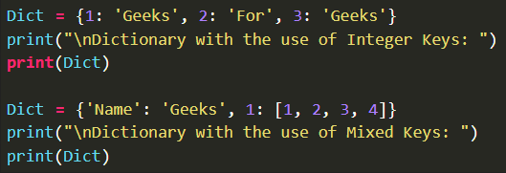
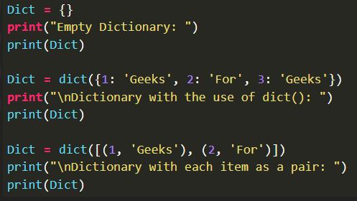
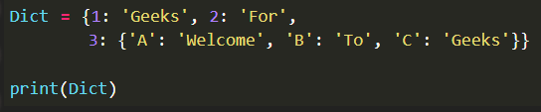
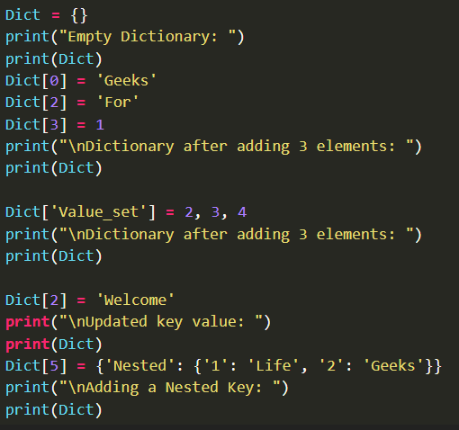
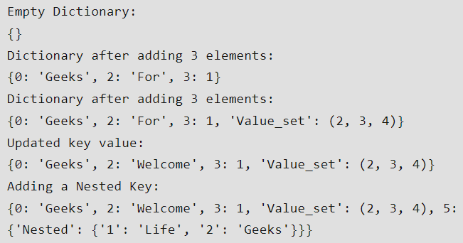
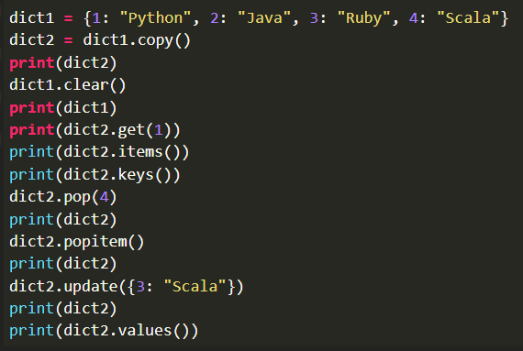
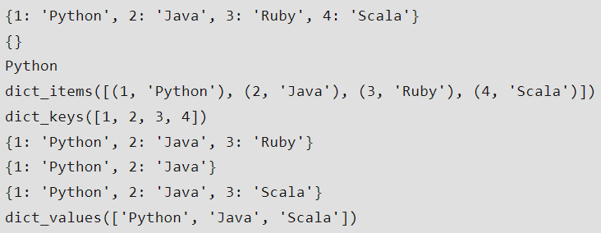
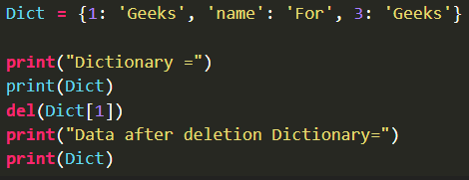



Dictionary (1)
형식 모음
글자
Dictionary → key : value (pairs) → Syntax: dir_val = {key1:val1, key2:val2, ...} → It’s different from list, tuple, array cuz each key has associated value(as of Python 3.7, dic_val are ordered and can’t contain duplicated keys) → value can be of any data type, can be duplicated → Using dict(), It can be created dictionary → Use indexing to add elements or Use update() Ex) Dict = {}, Dict[0] = ‘Hello’ → To access value of dictionary, refer to key name or get(key name) → To delete element, use del(val_name[key_name]) → Method - dict.clear(): remove all elements - dict.copy(): return copy of dictionary - dict.get(key, default=“None”): return value of key - dict.items(): return list containing tuple for each key value pair - dict.keys(): return list containing dictionary’s key - dict.update(dict2): update dictionary with key-value pair - dict.values(): return list of all values of dictionary - pop(): remove element with specified key - popItem(): remove last inserted key-value pair - dict.setdefault(key, default=“None”): set key to default value if key isn’t specified - dict.has_key(key): return true if dictionary contains specified key - dict.fromkeys(seq, val): create dictionary from given sequence
메인 내용
코드
(x₁, y₁)
(x₂, y₂)
(x_{m}, y_{m})
Result
Inside first_space
Ctrl+ = ➔ 아래첨자 Ctrl + shift + = ➔ 윗첨자 Ctrl + space ➔ 복구 Shift + f3 ➔ 대소문자 변경
예시 표시
Partition
그림 설명
예시
Code
예시
code
Mismatch
글자설명
Pattern
(-2,-2) | (-2,-1) | (-2,0) | (-2,1) | (-2,2)
(-1,-2) | (-1,-1) | (-1,0) | (-1,1) | (-1,2)
(0,-2) | (0,-1) | (x,y) | (0,1) | (0,2)
(1,-2) | (1,-1) | (1,0) | (1,1) | (1,2)
(2,-2) | (2,-1) | (2,0) | (2,1) | (2,2)
Notes:
https://www.geeksforgeeks.org/python-dictionary/

Slide 13
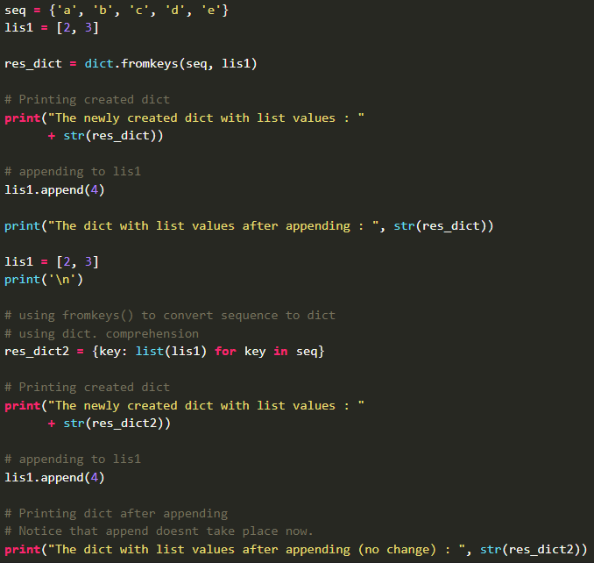
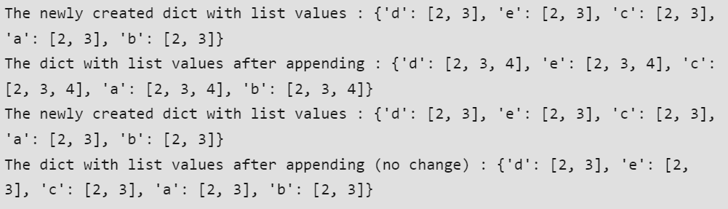
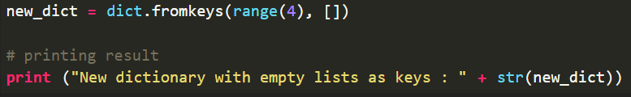
Dictionary (2)
형식 모음
글자
- dict.fromkeys(seq, val): create dictionary from given sequence → Shallow copy occurs(if append value in list, dictionary’s values are appended → must use {key: list(list_val) for key in sequence} for preventing aliasing
메인 내용
코드
(x₁, y₁)
(x₂, y₂)
(x_{m}, y_{m})
Result
Inside first_space
Ctrl+ = ➔ 아래첨자 Ctrl + shift + = ➔ 윗첨자 Ctrl + space ➔ 복구 Shift + f3 ➔ 대소문자 변경
예시 표시
Partition
그림 설명
예시
Code
예시
code
Mismatch
글자설명
Pattern
(-2,-2) | (-2,-1) | (-2,0) | (-2,1) | (-2,2)
(-1,-2) | (-1,-1) | (-1,0) | (-1,1) | (-1,2)
(0,-2) | (0,-1) | (x,y) | (0,1) | (0,2)
(1,-2) | (1,-1) | (1,0) | (1,1) | (1,2)
(2,-2) | (2,-1) | (2,0) | (2,1) | (2,2)
Notes:
https://www.geeksforgeeks.org/python-dictionary-fromkeys-method/

Slide 14
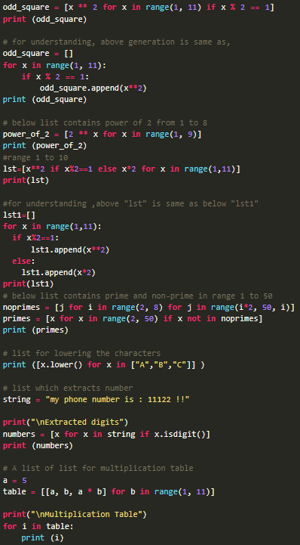
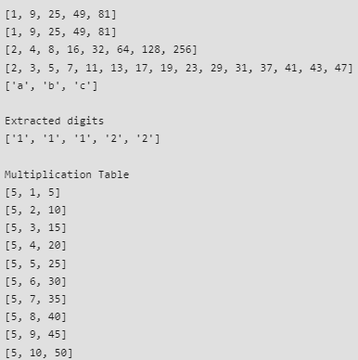
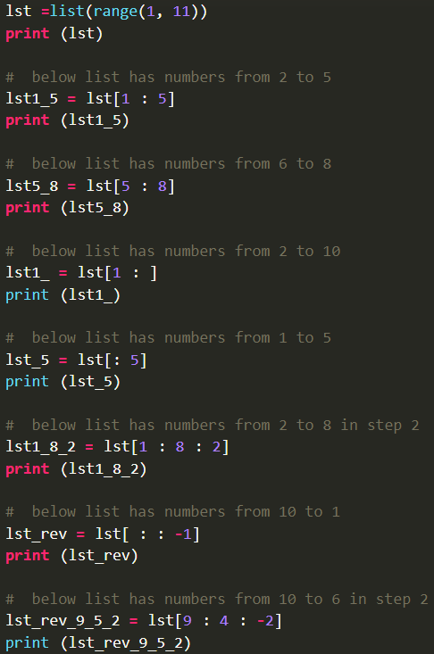
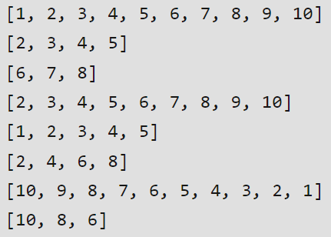
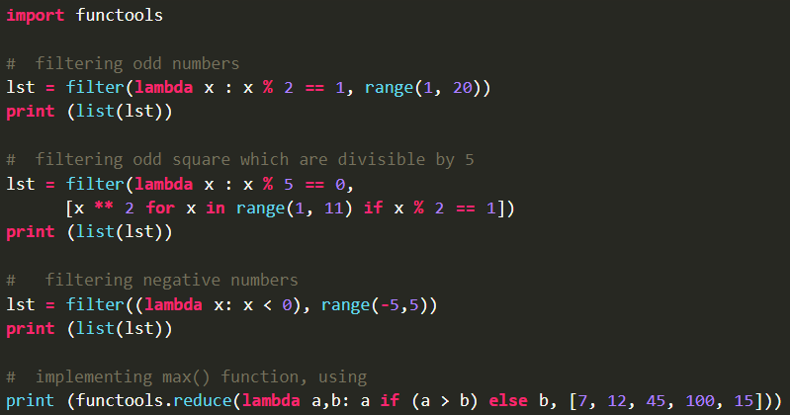
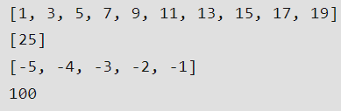
List Comprehension (1)
형식 모음
글자
List Comprehension Way to define and create list Component → Output expression → Input sequence → Variable → Optional predicate part → Ex) lst = [ x ** 2 for x in range(1, 11) if x % 2 == 1] Output expression: x ** 2 Input sequence: range(1, 11) Variable: x Predicate part: if x % 2 == 1 List slicing → Syntax: [start : stop : steps] - start default: 0, stop default: last index of list, step default: 1
메인 내용
코드
(x₁, y₁)
(x₂, y₂)
(x_{m}, y_{m})
Result
Inside first_space
Ctrl+ = ➔ 아래첨자 Ctrl + shift + = ➔ 윗첨자 Ctrl + space ➔ 복구 Shift + f3 ➔ 대소문자 변경
예시 표시
Partition
그림 설명
예시
Code
예시
code
Mismatch
글자설명
Pattern
(-2,-2) | (-2,-1) | (-2,0) | (-2,1) | (-2,2)
(-1,-2) | (-1,-1) | (-1,0) | (-1,1) | (-1,2)
(0,-2) | (0,-1) | (x,y) | (0,1) | (0,2)
(1,-2) | (1,-1) | (1,0) | (1,1) | (1,2)
(2,-2) | (2,-1) | (2,0) | (2,1) | (2,2)
Notes:
https://www.geeksforgeeks.org/python-list-comprehension-and-slicing/

Slide 15
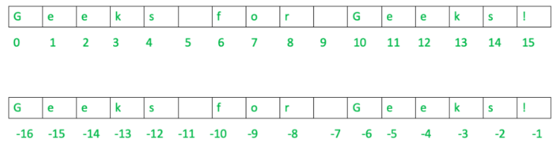
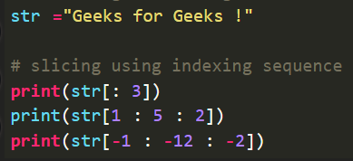

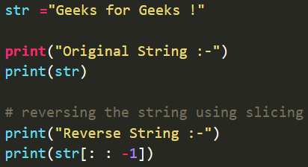
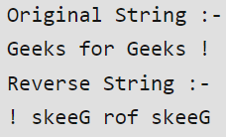
String Index and Slice
형식 모음
글자
String Index and Slice String data type is sequence made up of characters(letter, number, whitespace, symbol) Indexing: referring to element of iterable by position → Positive indexing: start 0(first element), last n → Negative indexing: start -1(last element), first –n Slicing: feature that enables accessing part of sequence(can create substring) → Syntax: string[start : end : step] - start/end: start/end index - step: optional argument that determines increment between each index for slicing
메인 내용
코드
(x₁, y₁)
(x₂, y₂)
(x_{m}, y_{m})
Result
Inside first_space
Ctrl+ = ➔ 아래첨자 Ctrl + shift + = ➔ 윗첨자 Ctrl + space ➔ 복구 Shift + f3 ➔ 대소문자 변경
예시 표시
Partition
그림 설명
예시
Code
예시
code
Mismatch
글자설명
Pattern
(-2,-2) | (-2,-1) | (-2,0) | (-2,1) | (-2,2)
(-1,-2) | (-1,-1) | (-1,0) | (-1,1) | (-1,2)
(0,-2) | (0,-1) | (x,y) | (0,1) | (0,2)
(1,-2) | (1,-1) | (1,0) | (1,1) | (1,2)
(2,-2) | (2,-1) | (2,0) | (2,1) | (2,2)
Notes:
https://www.geeksforgeeks.org/how-to-index-and-slice-strings-in-python/

Slide 16
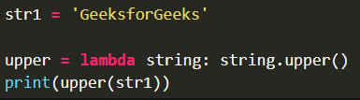

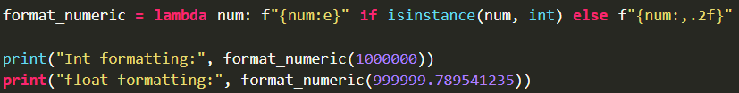





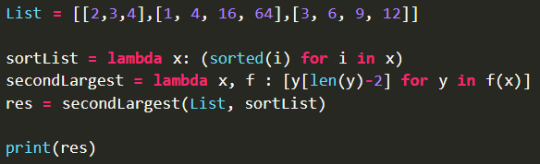

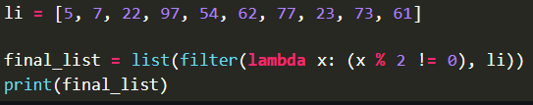

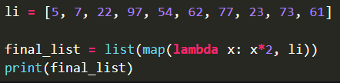
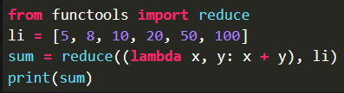

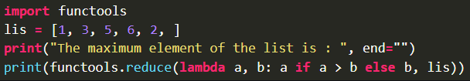
Lambda Function (1)
형식 모음
글자
Lambda Function anonymous function(=function without name) Syntax: lambda arguments : expression → Argument: 1<=, expression 1 ※ filter(function, list) Filter out all element of sequence(When condition is True) ※ reduce(function, list) reduce() belongs to functools module Return reduced result
메인 내용
코드
(x₁, y₁)
(x₂, y₂)
(x_{m}, y_{m})
Result
Inside first_space
Ctrl+ = ➔ 아래첨자 Ctrl + shift + = ➔ 윗첨자 Ctrl + space ➔ 복구 Shift + f3 ➔ 대소문자 변경
예시 표시
Partition
그림 설명
예시
Code
예시
code
Mismatch
글자설명
Pattern
(-2,-2) | (-2,-1) | (-2,0) | (-2,1) | (-2,2)
(-1,-2) | (-1,-1) | (-1,0) | (-1,1) | (-1,2)
(0,-2) | (0,-1) | (x,y) | (0,1) | (0,2)
(1,-2) | (1,-1) | (1,0) | (1,1) | (1,2)
(2,-2) | (2,-1) | (2,0) | (2,1) | (2,2)
Notes:
https://www.geeksforgeeks.org/python-lambda-anonymous-functions-filter-map-reduce/

